Slide 1
ICDL Data Analytics - Foundation Syllabus 1.0 Training MS Excel 2016 and MS Power BI
4 - Data Visualization
Lessons 10-13
<insert Name of Presenter>
Notes:
Instructor notes:
This presentation is a resource for instructors designed to be used in conjunction with the ICDL Data Analytics – Foundation Learning Materials. There are references in the notes on each slide to the relevant lesson in the learning materials.
There is a course outline document that can be modified and shared with participants in advance of the training. See ICDL Data Analytics - Foundation1.0_course_outline.docx.
Note: Lesson 12-Creating Additional Data Visualizations goes beyond the ICDL Data Analytics – Foundation syllabus by providing additional skills that learners may find useful when creating reports. Whether trainers cover the content in this lesson will depend on factors such as the learner’s abilities and the training schedule.
There are notes provided in the slides to give high level guidance / directions for the instructor on the content that needs to be covered in the slides.
Instructors will need to localise and tailor the presentation to suit the needs of their audience and local market. For example:
Modify the content to use applications that are relevant for your audience/local market. The applications referenced in the practical lessons here are:
Microsoft Excel 2016
Microsoft Power BI Desktop
Microsoft Power BI Service
Modify the content to use examples and scenarios that are relevant for your audience/local market.
Modify the content to suit your audience’s understanding of the subject matter. For example, provide additional explanations or introductory information if needed or focus on more advanced content as relevant.
Modify the content to suit your teaching, learning and assessment strategy.
Practical content: The instructor should decide the best approach to this for their audience. For example, they may choose to demonstrate practical steps in the relevant tool and facilitate learners practicing the steps after a demonstration. Or they may facilitate learners trying the steps themselves in the relevant tool without a demonstration.
Note: Where possible the steps to complete a discrete task have been included on one slide to allow learners refer to the steps on a shared screen while completing the steps on an individual computer.
Review exercises: These are provided at the end of each lesson in the learning materials and are designed to allow the learners to reinforce their newly acquired knowledge and skills through practice. Modify and develop additional/new review exercises as required to suit your audience.
Resources: Include additional resources such as videos, animations, images, statistics, cheat sheets etc. relevant to your audience as required.

Slide 2

4 - Data Visualization
Agenda
Lesson 10 – Data Visualization Tools
Lesson 11 – Creating Basic Data Visualizations
Lesson 12 – Creating Additional Data Visualizations
Lesson 13 – Publishing and Sharing
Notes:
Instructor notes:
Outline the agenda
Note: Lesson 12-Creating Additional Data Visualizations goes beyond the ICDL Data Analytics – Foundation syllabus by providing additional skills that learners may find useful when creating reports. Whether trainers cover the content in this lesson will depend on factors such as the learner’s abilities and the training schedule.

Slide 3

4 - Data Visualization
Learning Objectives Overview
After completing these lessons, you should be able to:
Understand data visualization techniques and tools.
Apply data visualization techniques and tools.
Create reports and dashboards in a data visualization tool.
Share reports and dashboards in a data visualization tool.
Notes:
Instructor notes:
Review session/category level learning objectives

Slide 4
Data Visualization Tools
Lesson 10

Slide 5
10 – Data Visualization Tools
Learning Objectives
After completing this lesson, you should be able to:
Understand the concept of data visualization using reports and dashboards.
Outline common visualizations.
Recognise common data visualization tools and their functions.
Setup tools for data visualizations.
Import data from a spreadsheet into a data visualization tool.
Notes:
Instructor notes:
Review Lesson Leaning Objectives

Slide 6

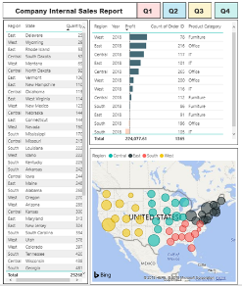
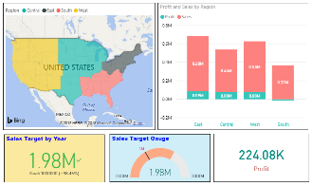
10 – Data Visualization Tools
Concepts: Understand the concept of data visualization using reports and dashboards.
Data visualizations
Provide a visual way to access data.
Used to display
Summary information
Key insights
Trends
Patterns
Can be interactive for ongoing analysis
filtering data
drilling into data
Notes:
Instructor notes:
Cover content in learning materials
References:
ICDL Data Analytics - Foundation 1.0 (10.1 Key Features of Data Visualization Tools)
Further Resources:

Slide 7
10 – Data Visualization Tools
Concepts: Understand the concept of data visualization using reports and dashboards.
Reports
Include one or more pages of data visualizations.
Used to share business intelligence and insights resulting from the data analytic process
Can contain interactive features.
A Report with Tabular Data and Charts
Notes:
Instructor notes:
Cover content in learning materials
References:
ICDL Data Analytics - Foundation 1.0 (10.1 Key Features of Data Visualization Tools)
Further Resources:

Slide 8
10 – Data Visualization Tools
Concepts: Understand the concept of data visualization using reports and dashboards.
Dashboards
Can include multiple visualizations pinned from reports.
Display key information and metrics on a single screen to be viewed at a glance.
Useful for monitoring changes.
Useful for gaining business insights in real-time.
A Dashboard with Multiple Charts and Visual Elements
Notes:
Instructor notes:
Cover content in learning materials
References:
ICDL Data Analytics - Foundation 1.0 (10.1 Key Features of Data Visualization Tools)
Further Resources:

Slide 9
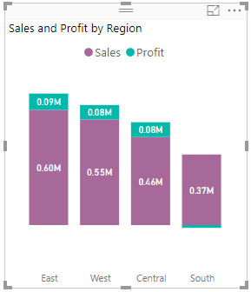
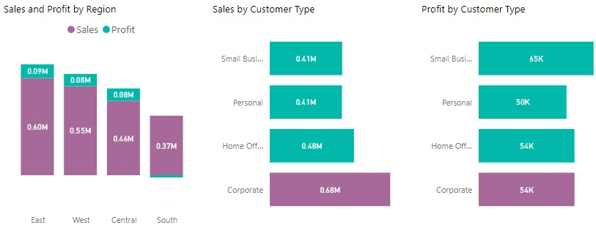
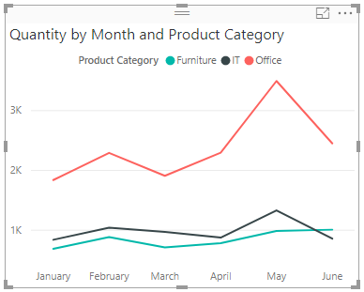
10 – Data Visualization Tools
Concepts: Outline common visualizations.
Charts
Useful for conveying numerical data across categories or time scales.
Reveal similarities, differences and trends among multiple values.
Column Chart
Bar Chart
Line Chart
Donut/Pie Chart
Notes:
Instructor notes:
Cover content in learning materials
References:
ICDL Data Analytics - Foundation 1.0 (10.1 Key Features of Data Visualization Tools)
Further Resources:

Slide 10
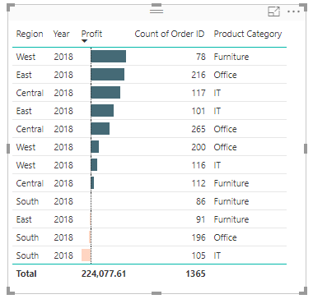
10 – Data Visualization Tools
Concepts: Outline common visualizations.
Tables
Useful for presenting and comparing detailed data and exact values.
Product Sales Table
Notes:
Instructor notes:
Cover content in learning materials
References:
ICDL Data Analytics - Foundation 1.0 (10.1 Key Features of Data Visualization Tools)
Further Resources:

Slide 11


10 – Data Visualization Tools
Concepts: Outline common visualizations.
Key performance indicators (KPIs)
Useful for
highlighting critical data
measuring performance and progress towards a goal
KPIs
Gauge Charts
Sales Target KPI
Sales Target Gauge Chart
Notes:
Instructor notes:
Cover content in learning materials
References:
ICDL Data Analytics - Foundation 1.0 (10.1 Key Features of Data Visualization Tools)
Further Resources:

Slide 12
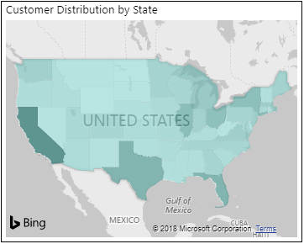
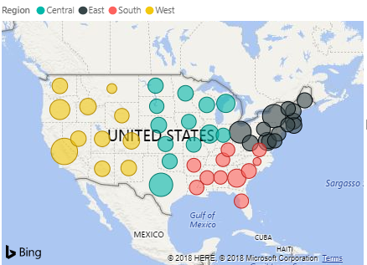
10 – Data Visualization Tools
Concepts: Outline common visualizations.
Maps
Useful for presenting quantitative information according to location.
Give an overview of data distribution across geographic locations.
Visually highlight best and worst performing areas, trends and outliers.
Filled Map
Bubble Map
Notes:
Instructor notes:
Cover content in learning materials
References:
ICDL Data Analytics - Foundation 1.0 (10.1 Key Features of Data Visualization Tools)
Further Resources:

Slide 13


10 – Data Visualization Tools
Concepts: Recognise common data visualization tools.
Tableau Public
A free web-based platform for creating data visualizations, which are uploaded to its public website for sharing.
Microsoft Power BI
A suite of tools including
Power BI Desktop (free desktop application)
Power BI service (online platform with different licensing options)
Power BI mobile apps
Notes:
Instructor notes:
Cover content in learning materials
References:
ICDL Data Analytics - Foundation 1.0 (10.2 Data Visualization Tools Setup)
Further Resources:

Slide 14

10 – Data Visualization Tools
Concepts: Recognise common data visualization tool functions.
1. Connect to data sources
2. Create data sets
3. Visualise data
4. Publish and share business intelligence
For example
For example
Text file
Spreadsheet
Web
Database
Reports
Dashboards
Notes:
Instructor notes:
Cover content in learning materials
References:
ICDL Data Analytics - Foundation 1.0 (10.2 Data Visualization Tools Setup)
Further Resources:

Slide 15

10 – Data Visualization Tools
Concepts: Recognise common data visualization tool functions.
1. Connect to data sources
2. Create data sets
3. Visualise data
4. Publish and share business intelligence
Reports: Create in Desktop
or service
Share from service only.
Desktop
or service
Desktop
or service
Dashboards:
Create in service only
Notes:
Instructor notes:
Cover content in learning materials
References:
ICDL Data Analytics - Foundation 1.0 (10.2 Data Visualization Tools Setup)
Further Resources:

Slide 16



10 – Data Visualization Tools
Task: Access a Data Visualization Tool.
Example: Download Microsoft Power BI Desktop.
Steps:
Go to the Microsoft Power BI Desktop download page: https://powerbi.microsoft.com/en-us/desktop.
Click on DOWNLOAD FREE to begin the process of downloading.
When Power BI Desktop is downloaded, run the installation file.
Follow the instructions in the setup wizard to install the application.
Alternatively, download Power BI Desktop as an app at the Microsoft Store.
Notes:
Instructor notes:
Cover content in learning materials
References:
ICDL Data Analytics - Foundation 1.0 (10.2 Data Visualization Tools Setup)
Further Resources:

Slide 17

10 – Data Visualization Tools
Task: Open a Data Visualization Tool.
Example: Open Microsoft Power BI Desktop.
Steps:
Double-click the Power BI Desktop app icon on your desktop.
Notes:
Instructor notes:
Cover content in learning materials
References:
ICDL Data Analytics - Foundation 1.0 (10.3 Visualization Tool Environment)
Further Resources:

Slide 18
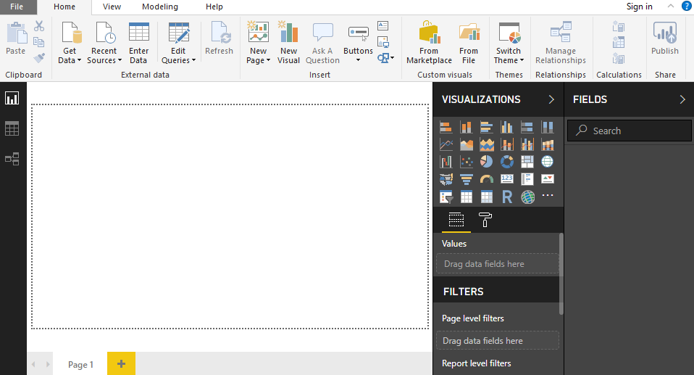
10 – Data Visualization Tools
Task: Navigate a Data Visualization Tool’s environment.
Example: Explore the Power BI Desktop Interface.
①
Ribbon: where you get data, publish to Power BI service etc.
②
Report View: build reports.
Data View: underlying data.
select data to include
④
⑤
Relationship View: relationships between fields in different data sets.
Report canvas: display/arrange visualizations
select visualizations/display options
select data to display
③
Pages tab: add pages to reports
Notes:
Instructor notes:
Cover content in learning materials.
References:
ICDL Data Analytics - Foundation 1.0 (10.3 Visualization Tool Environment)
Further Resources:

Slide 19
10 – Data Visualization Tools
Task: Import a data set from a spreadsheet into a data visualization tool and save the file.
Example: Import the data set Table2 from Excel into Power BI Desktop.
Steps:
Open the Power BI Desktop app, if not already open.
On the Home tab, in the External Data group, click Get Data.
Select Excel in the Get Data menu.
Locate and select the Sales Format.xlsx file and click Open.
Check the Table2 option under Display Options.
Click Load.
Click the Data View icon on the left to view the data.
Click File and choose Save.
Type Report in the File name box and click Save.
Notes:
Instructor notes:
Cover content in learning materials
References:
ICDL Data Analytics - Foundation 1.0 (10.4 Importing Data Sets from Spreadsheets)
Further Resources:

Slide 20
10 – Data Visualization Tools
Task: Import a data set from a spreadsheet into a data visualization tool and save the file.
Example: Import a data set Table2 from Excel into Power BI Desktop.
Result: The data will be saved as a Report Power BI file (Report.pbix).
Notes:
Instructor notes:
Cover content in learning materials
References:
ICDL Data Analytics - Foundation 1.0 (10.4 Importing Data Sets from Spreadsheets)
Further Resources:

Slide 21


10 – Data Visualization Tools
Learning Objectives Review
You should now be able to:
Understand the concept of data visualization using reports and dashboards.
Outline common visualizations.
Recognise common data visualization tools and their functions.
Setup tools for data visualizations.
Import data from a spreadsheet into a data visualization tool.
Notes:
Instructor Notes:
Review learning objectives

Slide 22


10 – Data Visualization Tools
Review Exercise
Notes:
Instructor notes:
Ask participants to complete the Review Exercise to review their knowledge and practice their skills and support them as required.
They will need access to Power BI Desktop
Review answers with the group
Question answers
1 d)
2 a)
3 c)
4 d)
5 b)
6 (2)
7 Sales overview imported.pbxi saved in Power BI Desktop
References:
ICDL Data Analytics - Foundation 1.0 (10.5 Review Exercise - page 142)
Relevant workfiles in Student folder (sales overview.xlsx)

Slide 23
Creating Basic Data Visualizations
Lesson 11

Slide 24
11 – Creating Basic Data Visualizations
Learning Objectives
After completing this lesson, you should be able to:
Create table visualizations
Create chart visualizations
Enhance visualizations using conditional formatting
Enhance visualizations using data bars
Enhance visualizations using visual level filters
Create visualizations using maps
Notes:
Instructor Notes:
Review learning objectives

Slide 25
11 – Creating Basic Data Visualizations
Task: Create tables in a report.
Example: Create a Table visualization in a report to compare 2017 and 2018 sales performance.
Steps:
Open Power BI Desktop and click File – Open.
Select TableChart.pbxi and click Open.
In Report view, click the Table icon in the Visualizations pane.
Select 2017 Sales, 2018 Sales and Country fields from the Fields pane. .
Select the table and click the Format icon.
Click Field formatting and set font color of 2017 Sales to green and background color to white.
Click the down arrow next to 2017 Sales to change the field to 2018 Sales. Set the background color of 2018 Sales to yellow.
Save the file as TableChart Added Power BI file.
Notes:
Instructor notes:
Cover content in learning materials
References:
ICDL Data Analytics - Foundation 1.0 (11.1 Creating Table Visualizations)
Further Resources:

Slide 26
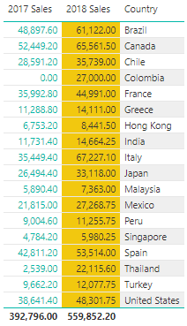
11 – Creating Basic Data Visualizations
Task: Create tables in a report.
Example: Create a Table visualization in a report to compare 2017 and 2018 sales performance.
Result: The formatted table is updated on the report canvas.
Formatted Sales Table
Notes:
Instructor notes:
Cover content in learning materials
References:
ICDL Data Analytics - Foundation 1.0 (11.1 Creating Table Visualizations)
Further Resources:

Slide 27
11 – Creating Basic Data Visualizations
Task: Visualize data as a line chart.
Example: Create a line chart visualization to plot sales and profit values by month.
Steps:
Open Sales Chart.pbxi.
In Report view, select the Line chart icon in the Visualizations pane.
Select Order Date, Sales, and Profit fields in the Fields pane.
To display the Order Date by month, deselect Year, Quarter, Day by clicking the x symbols.
Size the line chart to display all information clearly.
Click the Format icon.
Click Legend and set Position to Top Center.
Expand the Data colors section and set Sales: Purple and Profit: Green.
Expand the Shapes section and set Stroke width: 3, Show marker: On, and Marker shape: Diamond.
Expand the Title section and set Font colour: Black and Text size: 10.
Notes:
Instructor notes:
Cover content in learning materials
References:
ICDL Data Analytics - Foundation 1.0 (11.2 Creating Chart Visualizations)
Further Resources:

Slide 28
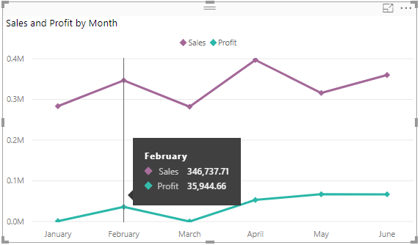
11 – Creating Basic Data Visualizations
Task: Visualize data as a line chart.
Example: Create a line chart visualization to plot sales and profit values by month.
Result: The formatted line chart is updated on the report canvas.
Highlighting a Data Point
Notes:
Instructor notes:
Cover content in learning materials
References:
ICDL Data Analytics - Foundation 1.0 (11.2 Creating Chart Visualizations)
Further Resources:

Slide 29
11 – Creating Basic Data Visualizations
Task: Visualize data as a pie chart.
Example: Create a donut chart visualization to show the sales distribution by percentage for various regions.
Steps:
In Report view with Sales Chart.pbxi open, click outside the Line Chart in the Report Canvas and select the Donut chart icon.
Alternatively create a pie chart by selecting the Pie chart icon in the Visualizations pane.
Select the Region and Sales fields under the Orders table in the Fields pane.
Click the Format icon.
Expand the Detail labels section and set Label style to Category, percent of total and Text size to 10
Expand the Title section and set the Title Text to Sales Distribution by Region, Font colour to Black and Text size to 10.
Position the formatted donut chart to the right of the line chart and resize it as necessary.
Change the donut chart to a pie chart by selecting the donut chart and clicking the Pie chart icon.
Notes:
Instructor notes:
Cover content in learning materials
References:
ICDL Data Analytics - Foundation 1.0 (11.2 Creating Chart Visualizations)
Further Resources:

Slide 30
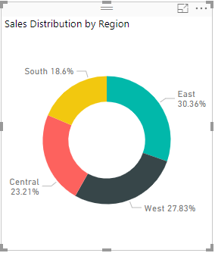
11 – Creating Basic Data Visualizations
Task: Visualize data as a pie chart.
Example: Create a donut chart visualization to show the sales distribution by percentage for various regions.
Result: The formatted donut chart is updated on the report canvas.
Formatted Donut Chart
Notes:
Instructor notes:
Cover content in learning materials
References:
ICDL Data Analytics - Foundation 1.0 (11.2 Creating Chart Visualizations)
Further Resources:

Slide 31
11 – Creating Basic Data Visualizations
Task: Visualize data as a column chart.
Example: Create a stacked column chart visualization to compare sales and profit figures across regions.
Steps:
In Report view with Sales Chart.pbxi open, click outside the charts in the Report Canvas area and select the Stacked column chart icon.
Select the Region, Sales and Profit fields under the Orders table in the Fields pane.
Click the Format icon.
Expand the Legend section and set the Position to Top Center and Text size to 10.
Slide the Y-Axis option to Off to turn off the y-axis display.
Expand the Data colours section and modify the series colour Sales to Purple and Profit to Green.
Slide the Data labels option to On to turn on the data labels.
Expand the Title section, set the Font colour to Black and Text size to 10.
Position the stacked column chart below the line chart and resize as necessary.
Notes:
Instructor notes:
Cover content in learning materials
References:
ICDL Data Analytics - Foundation 1.0 (11.2 Creating Chart Visualizations)
Further Resources:

Slide 32
11 – Creating Basic Data Visualizations
Task: Visualize data as a column chart.
Example: Create a stacked column chart visualization to compare sales and profit figures across the regions.
Result: The formatted stacked column chart is updated on the report canvas.
Formatted Stacked Column Chart
Notes:
Instructor notes:
Cover content in learning materials
References:
ICDL Data Analytics - Foundation 1.0 (11.2 Creating Chart Visualizations)
Further Resources:

Slide 33
11 – Creating Basic Data Visualizations
Task: Visualize data as a bar chart.
Example: Create a clustered bar chart visualization to compare sales figures across four customer types.
Steps:
In Sales Chart.pbxi, click outside the chart in the Report Canvas, and select the Clustered bar chart icon.
Select Customer Type and Sales fields under Orders table in Fields pane.
Click the Format icon.
Slide X-Axis option to Off.
Expand Data colours, set data colour for Corporate to Purple.
Slide Data labels to On.
Expand Data labels and set Position to Inside Center.
Expand Title and set Font colour to Black and Text size to 10.
Position the chart to the right of the stacked column chart and resize.
Select the clustered bar chart, click More options (the ellipses), and select Sort by Customer Type.
Notes:
Instructor notes:
Cover content in learning materials
References:
ICDL Data Analytics - Foundation 1.0 (11.2 Creating Chart Visualizations)
Further Resources:

Slide 34
11 – Creating Basic Data Visualizations
Task: Visualize data as a bar chart.
Example: Create a clustered bar chart visualization to compare sales figures across four customer types.
Result: The formatted clustered bar chart is updated on the report canvas.
Formatted Clustered Bar Chart
Notes:
Instructor notes:
Cover content in learning materials
References:
ICDL Data Analytics - Foundation 1.0 (11.2 Creating Chart Visualizations)
Further Resources:

Slide 35
11 – Creating Basic Data Visualizations
Task: Visualize data as a bar chart.
Example: Create a clustered bar chart visualization to compare profit figures across four customer types.
Steps:
Create a copy of the clustered bar chart visualization and position it to the right of the copied clustered bar chart.
Uncheck Sales and check Profit to change the field under Value to Profit.
A Clustered bar chart displaying Profit by Customer Type is created.
Align the three chart visualizations in a row with equal spacing in between.
Notes:
Instructor notes:
Cover content in learning materials
References:
ICDL Data Analytics - Foundation 1.0 (11.2 Creating Chart Visualizations)
Further Resources:

Slide 36
11 – Creating Basic Data Visualizations
Task: Visualize data as a bar chart.
Example: Create a clustered bar chart visualization to compare profit figures across four customer types.
Result: The Profit by Customer chart is displayed on the report canvas beside the Sales by Customer Type and Sales and Profit by Region charts.
Sales and Profit Charts
Notes:
Instructor notes:
Cover content in learning materials
References:
ICDL Data Analytics - Foundation 1.0 (11.2 Creating Chart Visualizations)
Further Resources:

Slide 37
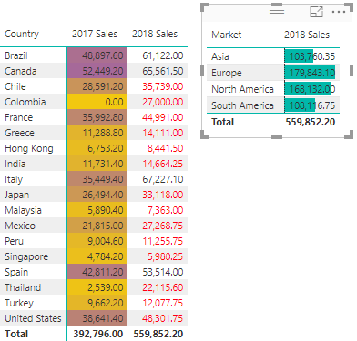
11 – Creating Basic Data Visualizations
Concepts: Enhancing Visualizations Using Conditional Formatting
You can use conditional formatting to highlight key summary features and important statistics such as:
maximum and minimum values
above and below average values
Options include:
①
③
Setting the background color based on values or rules
Showing values with data bars
②
Setting the font color based on values or rules
Notes:
Instructor notes:
Cover content in learning materials
References:
ICDL Data Analytics - Foundation 1.0 (11.3 Enhancing Visualizations Using Conditional Formatting)
Further Resources:

Slide 38
11 – Creating Basic Data Visualizations
Task: Apply and edit background conditional formatting.
Example: Set the Background color conditional formatting to highlight high and low sales figures by country for 2017.
Steps:
Open Sales Chart Enhanced Power BI file.
In Report view, click on the table visualization.
Go to 2017 Sales in the Values area, click the field’s down arrow.
Select Conditional Formatting and click Background color.
Set yellow in the Minimum area and purple in the Maximum area
Click OK.
Resize the table to ensure all the values are visible.
Edit and remove Background color conditional formatting by selecting the field’s down arrow and following the appropriate steps.
Notes:
Instructor notes:
Cover content in learning materials
References:
ICDL Data Analytics - Foundation 1.0 (11.3 Enhancing Visualizations Using Conditional Formatting)
Further Resources:

Slide 39
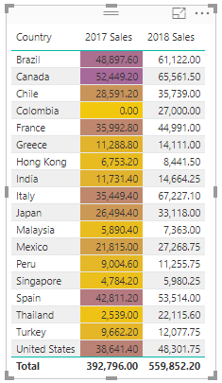
11 – Creating Basic Data Visualizations
Task: Apply and edit background conditional formatting.
Example: Set the Background color conditional formatting to highlight high and low sales figures by country for 2017.
Result: The background color conditional
formatting is applied where
yellow is the minimum value
purple is the highest value
Background Conditional Formatting applied to 2017 sales
Notes:
Instructor notes:
Cover content in learning materials
References:
ICDL Data Analytics - Foundation 1.0 (11.3 Enhancing Visualizations Using Conditional Formatting)
Further Resources:

Slide 40
11 – Creating Basic Data Visualizations
Task: Apply and edit font conditional formatting.
Example: Set the Font color conditional formatting to highlight sales figures in the range of 0 to 49999 for 2018.
Steps:
In the Sales Chart Enhanced file, in the Values area, click 2018 Sales field’s down arrow, and select Conditional Formatting.
Click Font color.
Click Color scale down arrow, set Format by to Rules option.
Set If value to is greater than or equal to 0 and is less than 50000 in the Rules area
Click OK.
Edit and remove Font color conditional formatting by selecting the field’s down arrow and following the appropriate steps.
Notes:
Instructor notes:
Cover content in learning materials
References:
ICDL Data Analytics - Foundation 1.0 (11.3 Enhancing Visualizations Using Conditional Formatting)
Further Resources:

Slide 41
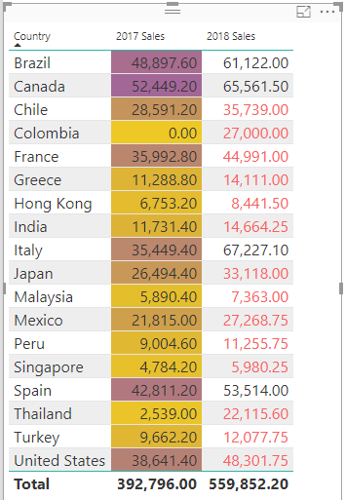
11 – Creating Basic Data Visualizations
Task: Apply and edit font conditional formatting.
Example: Set the Font color conditional formatting to highlight sales figures in the range of 0 to 49999 for 2018.
Result: The Font color conditional
formatting is applied where a value is
greater than or equal to 0
and less than 50000
Values are highlighted to show
the range and variation within the data set.
Font Color Conditional Formatting Applied to 2018 sales
Notes:
Instructor notes:
Cover content in learning materials
References:
ICDL Data Analytics - Foundation 1.0 (11.3 Enhancing Visualizations Using Conditional Formatting)
Further Resources:

Slide 42
11 – Creating Basic Data Visualizations
Task: Apply and edit data bars.
Example: Create a table to show 2018 sales figures by market and apply data bars to show the market share.
Steps:
In Sales Chart Enhanced, click outside the table and select the Table icon.
Select Market and 2018 Sales fields under the Table2 table in Fields pane.
Click 2018 Sales field’s down arrow and select Conditional Formatting.
Click Data bars.
Select the Minimum type down arrow, select Number, and type 0 in Value box.
Click the Positive bar down arrow, select green, and click OK.
Place the table visualization to the right of the first table and resize if necessary.
Edit and remove data bars by selecting the down arrow next to the relevant field and following the appropriate steps.
Notes:
Instructor notes:
Cover content in learning materials
References:
ICDL Data Analytics - Foundation 1.0 (11.3 Enhancing Visualizations Using Conditional Formatting)
Further Resources:

Slide 43
11 – Creating Basic Data Visualizations
Task: Apply and edit data bars.
Example: Create a table to show 2018 sales figures by market and apply data bars to show the market share.
Result: The data bars enhance the
table visualization to highlight the
market share of 2018 sales.
Table with data bars
Notes:
Instructor notes:
Cover content in learning materials
References:
ICDL Data Analytics - Foundation 1.0 (11.3 Enhancing Visualizations Using Conditional Formatting)
Further Resources:

Slide 44
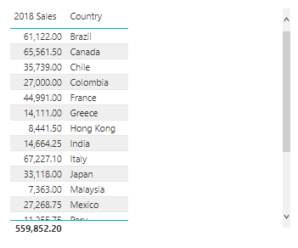

11 – Creating Basic Data Visualizations
Concepts: Enhancing Visualizations Using Visual Level Filters
If you want to visually inspect a specific section of a data set, you can apply a Visual Level Filter.
For numerical values - the items to display are selected by setting a rule (for example, is less than or equal to) and specifying a value.
For qualitative values - the items to display are selected from a list.
Visual level filters are saved with the file.
Notes:
Instructor notes:
Cover content in learning materials
References:
ICDL Data Analytics - Foundation 1.0 (11.4 Enhancing Visualizations Using Visual Level Filters)
Further Resources:

Slide 45
11 – Creating Basic Data Visualizations
Task: Apply visual level filters.
Example: Apply visual level filters to show 2018 sales figures less than 30000 and show Malaysia and Singapore only.
Steps:
Open Visual level filters.pbxi.
In Report view, click the table visualization to view the 2018 Sales listed by Country.
Click the down arrow next to 2018 Sales under Visual level filters.
Enter 30000 under Show items when the value and the option is less than and press Return.
Click the down arrow next to Country under Visual level filters.
Scroll and select Singapore and Malaysia.
Notes:
Instructor notes:
Cover content in learning materials
References:
ICDL Data Analytics - Foundation 1.0 (11.4 Enhancing Visualizations Using Visual Level Filters)
Further Resources:

Slide 46
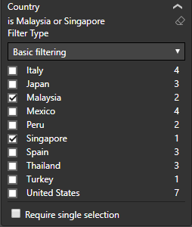
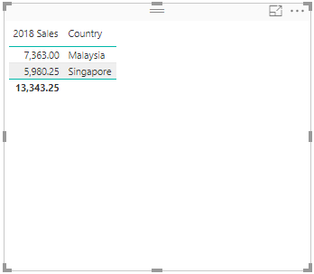
11 – Creating Basic Data Visualizations
Task: Apply visual level filters.
Example: Apply visual level filters to show 2018 sales figures less than 30000 and show Malaysia and Singapore only.
Result: 2018 Sales under 300000 shown for Malaysia and Singapore only.
Filtering applied
Notes:
Instructor notes:
Cover content in learning materials
References:
ICDL Data Analytics - Foundation 1.0 (11.4 Enhancing Visualizations Using Visual Level Filters)
Further Resources:

Slide 47
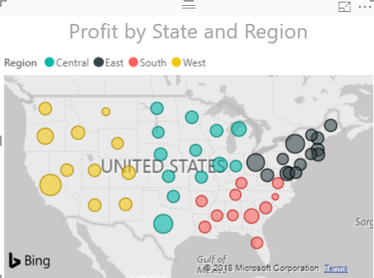
11 – Creating Basic Data Visualizations
Concepts: Creating Visualizations Using Maps
Bubble Map
Filled Map
Data size shown by bubble size.
Small (less-frequent/lower values) to Large (more-frequent/higher values).
Data size shown by shade.
Light (less-frequent/lower values) to Dark (more-frequent/higher values)
Bubble Map showing profit volume by state and region in the United States
Filled Map shows customer distribution by state in the United States
Notes:
Instructor notes:
Cover content in learning materials
References:
ICDL Data Analytics - Foundation 1.0 (11.5 Creating Visualizations Using Maps)
Further Resources:

Slide 48
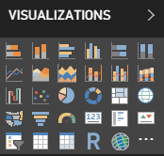
11 – Creating Basic Data Visualizations
Task: Create a map visualization.
Example: Create a bubble map showing sales volume by state.
Steps:
Open MapChart.pbix.
In Report view, select the Map icon in the Visualizations pane.
Select the fields to add to the map – State and Sales fields.
Notes:
Instructor notes:
Cover content in learning materials
References:
ICDL Data Analytics - Foundation 1.0 (11.5 Creating Visualizations Using Maps)
Further Resources:

Slide 49
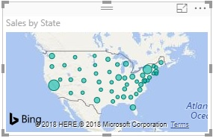
11 – Creating Basic Data Visualizations
Task: Create a map visualization.
Example: Create a bubble map showing sales volume by state.
Result: The map visualization is created showing the sales volume by state.
A Map chart of Sales by State and Sales
Notes:
Instructor notes:
Cover content in learning materials
References:
ICDL Data Analytics - Foundation 1.0 (11.5 Creating Visualizations Using Maps)
Further Resources:

Slide 50
11 – Creating Basic Data Visualizations
Task: Create a map visualization.
Example: Format the bubble map showing sales volume by state and highlight California.
Steps:
Click the Format icon below the visualization icons in the Visualizations pane.
Expand the Map styles section and change the Theme to Grayscale.
Slide the Border option to On.
Expand the Title section and set the Font colour to Black and Text size to 10.
Expand the Data colours section and change the Default colour to Yellow.
To highlight the sales for California on the map, slide the Show all option to On and change the colour for California to Green.
Expand the Bubbles section and set the Size to 5%.
Hover over a state to highlight the plotted value.
Notes:
Instructor notes:
Cover content in learning materials
References:
ICDL Data Analytics - Foundation 1.0 (11.5 Creating Visualizations Using Maps)
Further Resources:

Slide 51
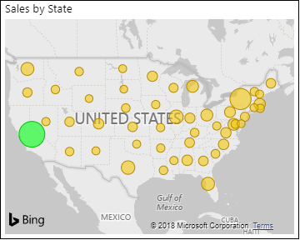
11 – Creating Basic Data Visualizations
Task: Create a map visualization.
Example: Format the bubble map showing sales volume by state and highlight California.
Result: The map shows the sales volume by state with a special highlight for California for quick comparison.
A Map chart of Sales by State and Sales highlighted for California
Notes:
Instructor notes:
Cover content in learning materials
References:
ICDL Data Analytics - Foundation 1.0 (11.5 Creating Visualizations Using Maps)
Further Resources:

Slide 52
11 – Creating Basic Data Visualizations
Task: Create a map visualization.
Example: Create a filled map showing customer distribution by state.
Steps:
In MapChart.pbix click on an area outside the bubble map in the Report Canvas and select the Filled Map icon in the Visualizations pane.
Select the fields to add to the map – State and Customer ID.
Drag and drop Customer ID to the Color saturation area.
Click the Count of Customer ID field’s drop down list in the Color saturation area and select the function Count (Distinct).
Notes:
Instructor notes:
Cover content in learning materials
References:
ICDL Data Analytics - Foundation 1.0 (11.5 Creating Visualizations Using Maps)
Further Resources:

Slide 53
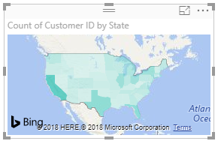
11 – Creating Basic Data Visualizations
Task: Create a map visualization.
Example: Create a filled map showing customer distribution by state.
Result: The map visualization is created showing customer distribution by state.
A Filled Map chart
Notes:
Instructor notes:
Cover content in learning materials
References:
ICDL Data Analytics - Foundation 1.0 (11.5 Creating Visualizations Using Maps)
Further Resources:

Slide 54
11 – Creating Basic Data Visualizations
Task: Create a map visualization.
Example: Format the filled map showing customer distribution by state.
Steps:
Click the Format icon in the Visualizations pane.
Expand the Map styles section and change the Theme to Grayscale.
Expand the Title section and set the Title Text to Customer Distribution by State, Font colour to Black, and Text size to 10.
Slide the Border option to On.
Move the filled map to beneath the bubble map and resize the filled map as necessary.
Hover over a state to highlight the plotted value.
Notes:
Instructor notes:
Cover content in learning materials
References:
ICDL Data Analytics - Foundation 1.0 (11.5 Creating Visualizations Using Maps)
Further Resources:

Slide 55
11 – Creating Basic Data Visualizations
Task: Create a map visualization.
Example: Format the filled map showing customer distribution by state.
Result: The Filled map gives an overview on the count of customers by state.
A Map chart of Customer Distribution by State
Notes:
Instructor notes:
Cover content in learning materials
References:
ICDL Data Analytics - Foundation 1.0 (11.5 Creating Visualizations Using Maps)
Further Resources:

Slide 56
11 – Creating Basic Data Visualizations
Learning Objectives Review
You should now be able to:
Create table visualizations
Create chart visualizations
Enhance visualizations using conditional formatting
Enhance visualizations using data bars
Enhance visualizations using visual level filters
Create visualizations using maps
Notes:
Instructor Notes:
Review learning objectives

Slide 57
11 – Creating Basic Data Visualizations
Review Exercise
Notes:
Instructor notes:
Ask participants to complete the Review Exercise to review their knowledge and practice their skills and support them as required.
They will need access to Power BI Desktop
Review answers with the group
Question answers
1 c)
2-10 see Chartstory solution.pbxi
References:
ICDL Data Analytics - Foundation 1.0 (11.6 Review Exercise - page 174)
Relevant workfiles in Student folder (Chartstory.pbxi, PivotReport.pbxi) and solution file (Chartstory solution.pbxi)

Slide 58
Creating Additional data visualizations
Lesson 12
Notes:
Instructor notes:
The content in this Lesson goes beyond the ICDL Data Analytics – Foundation syllabus by providing additional skills that learners may find useful when creating reports.
Whether trainers cover the content in this lesson will depend on factors such as the learner’s abilities and the training schedule.
References:
ICDL Data Analytics - Foundation 1.0 (Lesson 12-Creating Additional Data Visualizations)

Slide 59
12 – Creating Additional Data Visualizations
Learning Objectives
After completing this lesson, you should be able to:
Create KPI and gauge chart visualizations to measure progress
Create card visualizations
Create matrix visualizations
Add interactivity using slicers
Notes:
Instructor notes:
The content in this Lesson goes beyond the ICDL Data Analytics – Foundation syllabus by providing additional skills that learners may find useful when creating reports.
Whether trainers cover the content in this lesson will depend on factors such as the learner’s abilities and the training schedule.
References:
ICDL Data Analytics - Foundation 1.0 (Lesson 12-Creating Additional Data Visualizations)

Slide 60
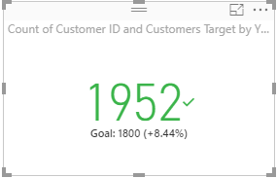
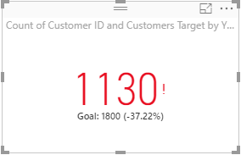
12 – Creating Additional Data Visualizations
Concepts: Creating Visualizations to Measure Progress
You can use a KPI visualization to show progress towards a goal in a report or dashboard.
Positive KPI: When current status exceeds the goal
Negative KPI: When current status is less than the goal
Notes:
Instructor notes:
Cover content in learning materials
References:
ICDL Data Analytics - Foundation 1.0 (12.1 Creating Visualizations to Measure Progress)
Further Resources:

Slide 61
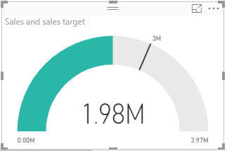
12 – Creating Additional Data Visualizations
Concepts: Creating Visualizations to Measure Progress
OR You can use a Gauge chart visualization to show progress towards a goal in a report or dashboard.
The goal
②
③
The current status
①
All possible values.
Notes:
Instructor notes:
Cover content in learning materials
References:
ICDL Data Analytics - Foundation 1.0 (12.1 Creating Visualizations to Measure Progress)
Further Resources:

Slide 62
12 – Creating Additional Data Visualizations
Task: Creating Visualizations to Measure Progress.
Example: Create a KPI to measure progress of a goal of 1800 customers this year.
Steps:
Open the KPI Power BI file.
To set the goal, click New Measure in the Calculations group.
In the Formula bar type Customers Target = 1800 and press Enter.
In the Report view, click a blank area in the Report Canvas and select the KPI icon.
Drag and drop Customer ID from Fields pane into Indicator area (base).
Drag and drop Order Date from Fields pane into Trend axis area.
Click Order Date drop down list in the Trend axis area and select Date Hierarchy.
Drag and drop Customers Target from Fields pane into Target goals area (target).
Click Count of Customer ID field in Indicator area, change aggregation to Count (Distinct).
Click the Format icon.
In Title section set Title Text to Customers KPI, Font colour to Black, Text size to 10
Slide Border to On.
Position the KPI to the right of the bubble map and resize it as necessary.
Notes:
Instructor notes:
Cover content in learning materials
References:
ICDL Data Analytics - Foundation 1.0 (12.1 Creating Visualizations to Measure Progress)
Further Resources:

Slide 63
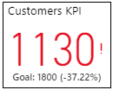
12 – Creating Additional Data Visualizations
Task: Creating Visualizations to Measure Progress.
Example: Create a KPI to measure progress of a goal of 1800 customers this year.
Result: The Customers KPI is updated on the report canvas – showing a negative KPI.
Formatted KPI with unique customer IDs counted
Notes:
Instructor notes:
Cover content in learning materials
References:
ICDL Data Analytics - Foundation 1.0 (12.1 Creating Visualizations to Measure Progress)
Further Resources:

Slide 64
12 – Creating Additional Data Visualizations
Task: Creating Visualizations to Measure Progress.
Example: Create a KPI to measure progress of a goal of 1300 orders.
Steps:
In the KPI Power BI file make a copy of Customers KPI below the original Customers KPI.
To set the target, create a new measure Orders Target with a value of 1300.
Select the copied KPI and set these options in the Visualizations pane:
Indicator: Order ID
Aggregation method: Count (Distinct)
Trend Axis: Order Date
Order Date Hierarchy: Year
Target goals: Orders Target
Title: Orders KPI
Notes:
Instructor notes:
Cover content in learning materials
References:
ICDL Data Analytics - Foundation 1.0 (12.1 Creating Visualizations to Measure Progress)
Further Resources:

Slide 65
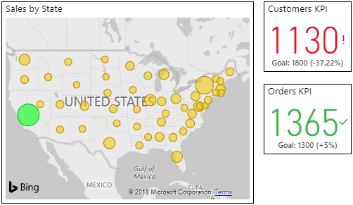
12 – Creating Additional Data Visualizations
Task: Creating Visualizations to Measure Progress.
Example: Create a KPI to measure progress of a goal of 1300 orders.
Result: The Orders KPI is updated on the report canvas – showing a positive KPI.
Customer and Order KPI added
Notes:
Instructor notes:
Cover content in learning materials
References:
ICDL Data Analytics - Foundation 1.0 (12.1 Creating Visualizations to Measure Progress)
Further Resources:

Slide 66
12 – Creating Additional Data Visualizations
Task: Creating Visualizations to Measure Progress.
Example: Create a gauge chart to measure progress of a goal of sales of 2500000.
Steps:
Open the KPI Solution Power BI file.
Select the Gauge icon in the Visualizations pane.
Create a new measure of Sales Target & value 2500000.
Drag and drop the Sales field into the Value area.
Drag and drop the field Sales Target into the Target value area.
Click the Format icon.
Expand the Gauge axis section and set Max to 3000000.
Slide Border to On.
In the Title section set the Title Text to Sales Target, Font colour to Black, and Text size to 10.
In the Target section, set to On and value decimal places to 2.
Position gauge below Orders KPI.
Notes:
Instructor notes:
Cover content in learning materials
References:
ICDL Data Analytics - Foundation 1.0 (12.1 Creating Visualizations to Measure Progress)
Further Resources:

Slide 67
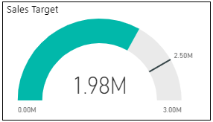
12 – Creating Additional Data Visualizations
Task: Creating Visualizations to Measure Progress.
Example: Create a gauge chart to measure progress of a goal of sales of 2500000.
Result: The Sales Gauge chart is updated on the report canvas – showing the goal hasn’t been met yet.
Steps:
Save the file as Gauge added Power BI file
Gauge chart added
Notes:
Instructor notes:
Cover content in learning materials
References:
ICDL Data Analytics - Foundation 1.0 (12.1 Creating Visualizations to Measure Progress)
Further Resources:

Slide 68
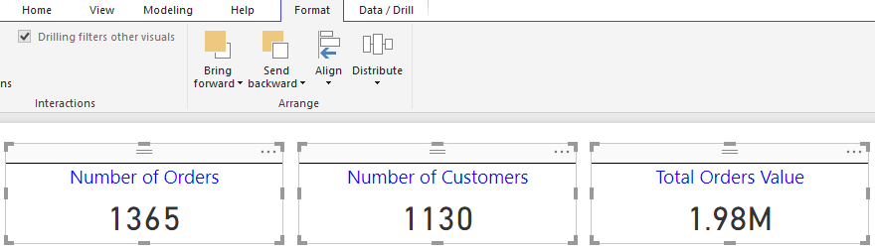
12 – Creating Additional Data Visualizations
Concepts: Creating Card Visualizations
You may want to show single summary values in a report such as
Total number of orders
Total number of customers
Total value of orders
You can use the Card visualization for showing single values.
Notes:
Instructor notes:
Cover content in learning materials
References:
ICDL Data Analytics - Foundation 1.0 (12.2 Creating Card Visualizations)
Further Resources:

Slide 69
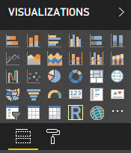
12 – Creating Additional Data Visualizations
Task: Creating Card Visualizations.
Example: Create a card to display the number of orders.
Steps:
Open the Orders Card Power BI file.
In the Report view, select the Card icon.
Select the Order ID field.
Click First Order ID field’s down arrow, select Count (Distinct).
Click the Format icon.
Slide the Category label option to Off.
Slide the Border and Title options to On.
In the Title section type Number of Orders in the Title Text box.
Select a blue font colour, center align the title and set font size to 14.
Adjust the height to minimize white space.
In the Data label section, set the Text size to 28.
Notes:
Instructor notes:
Cover content in learning materials
References:
ICDL Data Analytics - Foundation 1.0 (12.2 Creating Card Visualizations)
Further Resources:

Slide 70
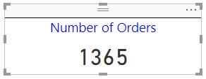
12 – Creating Additional Data Visualizations
Task: Creating Card Visualizations.
Example: Create a card to display the number of orders.
Result: The card is updated on the report canvas.
Card visualization added
Notes:
Instructor notes:
Cover content in learning materials
References:
ICDL Data Analytics - Foundation 1.0 (12.2 Creating Card Visualizations)
Further Resources:

Slide 71
12 – Creating Additional Data Visualizations
Task: Creating Card Visualizations.
Example: Create cards to display number of customers and total sales.
Steps:
Copy the Number or orders card and paste it twice on the right.
Edit the 2 new cards as follows:
Press CTRL and click to select each card.
On the Format tab, choose Align in the Arrange group, and choose Align Top.
Use Distribute in the Arrange group to distribute the cards equally.
 | Number of Customers | Total Sales
Field | Customer ID | Sales
Aggregation Method | Count (Distinct) | Sum
Title | Number of Customers | Total Orders Value
Notes:
Instructor notes:
Cover content in learning materials
References:
ICDL Data Analytics - Foundation 1.0 (12.2 Creating Card Visualizations)
Further Resources:

Slide 72
12 – Creating Additional Data Visualizations
Task: Creating Card Visualizations.
Example: Create cards to display number of customers and total sales.
Result: The cards are updated on the report canvas.
Card visualizations added
Notes:
Instructor notes:
Cover content in learning materials
References:
ICDL Data Analytics - Foundation 1.0 (12.2 Creating Card Visualizations)
Further Resources:

Slide 73
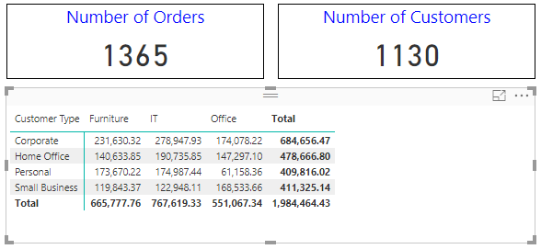
12 – Creating Additional Data Visualizations
Concepts: Creating Matrix Visualizations
You may want to communicate summary information in a report.
You can use the Matrix visualization to do this.
Notes:
Instructor notes:
Cover content in learning materials
References:
ICDL Data Analytics - Foundation 1.0 (12.3 Creating Matrix Visualizations)
Further Resources:

Slide 74
12 – Creating Additional Data Visualizations
Task: Creating Matrix Visualizations
Example: Create a matrix to display total sales for customer type and product category.
Steps:
Open Orders Card Solution Power BI file
Select the Matrix icon.
Drag and drop CustomerType to Rows, Product Category to Columns, Sales to Values
Position the matrix below the first card.
Adjust the width so that it spans the width of the first two cards.
Click the Format icon.
In the Matrix style section set the style to Minimal.
Expand the Grid section and set: Row padding: 2, Outline weight: 3, Text size: 10
In the Conditional formatting section slide the Data bars to On.
Slide Border to On.
Adjust the matrix so all values are visible without scrollbars.
Notes:
Instructor notes:
Cover content in learning materials
References:
ICDL Data Analytics - Foundation 1.0 (12.3 Creating Matrix Visualizations)
Further Resources:

Slide 75
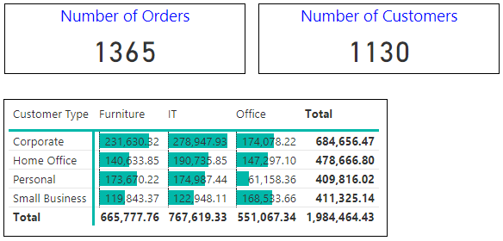
12 – Creating Additional Data Visualizations
Task: Creating Matrix Visualizations
Example: Create a matrix to display total sales for customer type and product category.
Result: The matrix is updated on the report canvas.
Matrix visualization added
Notes:
Instructor notes:
Cover content in learning materials
References:
ICDL Data Analytics - Foundation 1.0 (12.3 Creating Matrix Visualizations)
Further Resources:

Slide 76


12 – Creating Additional Data Visualizations
Concepts: Adding Interactivity Using Slicers
You may want to add interactivity to a report to allow users
view different aspects of the data
get additional insights
You can include slicers (similar to Excel Pivot Table slicers) to filter the report such as
Field slicers
Date slicers
Notes:
Instructor notes:
Cover content in learning materials
Note: Slicers can be inserted in two ways:
Select the Slicer icon in the Visualizations pane and then select the data field and drag it to the Fields box in the Visualizations pane.
Drag the data field from the Fields pane into the report canvas area, and then select the Slicer icon in the Visualizations panel to turn the visualization into a slicer.
References:
ICDL Data Analytics - Foundation 1.0 (12.4 Adding Interactivity Using Slicers)
Further Resources:

Slide 77
12 – Creating Additional Data Visualizations
Task: Inserting Slicers to add interactivity to reports
Example: Insert a slicer to enable filtering by Region in the Sales Summary report.
Steps:
Open the Sales Summary Power BI file.
Select the Slicer icon in the Visualizations pane.
Drag and drop the Region field into the Field area.
Position the slicer next to the matrix and resize as necessary.
Click the Format icon.
In the Selection Controls section slide Show “Select all” to On.
Slide the Slicer header to Off.
Slide the Title to On and set the following options:Title Text: View by region:, Font color: Black, Text size: 10
Resize the slicer as necessary.
Notes:
Instructor notes:
Cover content in learning materials
References:
ICDL Data Analytics - Foundation 1.0 (12.4 Adding Interactivity Using Slicers)
Further Resources:

Slide 78
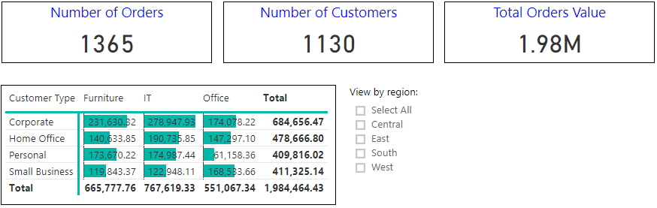
12 – Creating Additional Data Visualizations
Task: Inserting Slicers to add interactivity to reports
Example: Insert a slicer to enable filtering by Region in the Sales Summary report.
Result: The slicer is updated on the report canvas.
Slicer added
Notes:
Instructor notes:
Cover content in learning materials
References:
ICDL Data Analytics - Foundation 1.0 (12.4 Adding Interactivity Using Slicers)
Further Resources:

Slide 79
12 – Creating Additional Data Visualizations
Task: Inserting Slicers to add interactivity to reports
Example: Insert a date slicer in the report.
Steps:
In Sales Summary.pbxi drag and drop Order Date field to the report canvas.
Select the new visualization and select the Slicer icon in the Visualizations pane to convert it to a slicer.
Position the slicer next to the Region slicer and resize as required.
Click the Format icon.
Slide the Slicer Header to Off.
Slide the Title to On, expand the section and set:
Title Text: Select order date range: 1 January to 30 June 2018
Font color: Black
Text size: 10
Select different date ranges with the slider, or select a date field to type in a value or pop up a calendar for more precise selection.
Save the report as Orders Report Final Power BI file.
Notes:
Instructor notes:
Cover content in learning materials
Notes
The slider resizes with the slicer size, but it disappears and the dates are cut off if the slicer is too small.
The date data field produces a Between range slider slicer type by default. To change the slicer type, with the slicer selected, hover over the upper-right area of the slicer, click the drop down arrow that appears, and choose one of the other options, such as Before or After.
References:
ICDL Data Analytics - Foundation 1.0 (12.4 Adding Interactivity Using Slicers)
Further Resources:

Slide 80
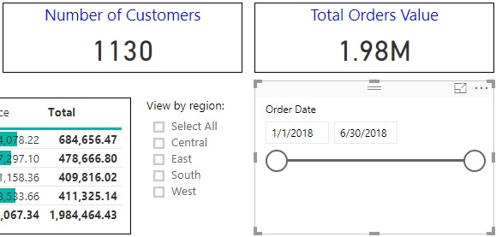
12 – Creating Additional Data Visualizations
Task: Inserting Slicers to add interactivity to reports
Example: Insert a date slicer in the report.
Result: The date slicer is updated on the report canvas and the report is saved as Orders Report Final.pbxi.
Slicer added
Notes:
Instructor notes:
Cover content in learning materials
References:
ICDL Data Analytics - Foundation 1.0 (12.4 Adding Interactivity Using Slicers)
Further Resources:

Slide 81
12 – Creating Additional Data Visualizations
Learning Objectives Review
You should now be able to:
Create KPI and gauge chart visualizations to measure progress
Create card visualizations
Create matrix visualizations
Add interactivity using slicers
Notes:
Instructor notes:
Review learning objectives

Slide 82
12 – Creating Additional Data Visualizations
Review Exercise
Notes:
Instructor notes:
Ask participants to complete the Review Exercise to review their knowledge and practice their skills and support them as required.
They will need access to Power BI Desktop
Review answers with the group
Question answers
1 d)
2-11 see Createsummary solution.pbxi
References:
ICDL Data Analytics - Foundation 1.0 (12.5 Review Exercise - page 194)
Relevant workfile in Student folder (Createsummary.pbxi) and solution file (Createsummary solution.pbxi)

Slide 83
Publishing and Sharing
Lesson 13

Slide 84
13 – Publishing and Sharing
Learning Objectives
After completing this lesson, you should be able to:
Publish a report from Power BI Desktop to the Power BI service
Share a report from the Power BI service using a link
Share a report from the Power BI service to the Web
Create a dashboard in the Power BI service
Share a dashboard in the Power BI service
Understand good design practice in reports and dashboards
Notes:
Instructor notes:
Cover learning objectives
References:
ICDL Data Analytics - Foundation 1.0 (Lesson 13 Publishing and Sharing)
Further Resources:

Slide 85


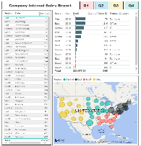



13 – Publishing and Sharing
Concepts: Creating and Preparing to Share Reports
Create Reports
In Power BI Desktop
In Power BI service
Free to access
Share Reports
Sender and Recipient need Power BI service with Pro license
Purchase full license
Trial version
Power BI Desktop or service
Power BI Service + Pro license
Power BI Service +
Pro license
Notes:
Instructor notes:
Cover content in learning materials
References:
ICDL Data Analytics - Foundation 1.0 (13.1 Creating and Preparing to Share Reports)
Further Resources:

Slide 86
13 – Publishing and Sharing
Task: Preparing to share reports
Example: Sign up for a free trial of the Power BI service with a Power BI Pro license.
Steps:
Go to Power BI signup page: https://powerbi.microsoft.com/en-us/get-started/.
On the get started page, select Try Free > under Power BI.
Type a work email address in the text box provided, and click Sign up.
Fill in required information such as name, password and country.
Check your email for a link or verification code email from Power BI.
Click the link to verify email address or key in the verification code and click Start.
If prompted to invite more people, click Skip.
Power BI service opens.
You cannot open an account with a personal email, it must be a work email.
Notes:
Instructor notes:
Cover content in learning materials
References:
ICDL Data Analytics - Foundation 1.0 (13.1 Creating and Preparing to Share Reports)
Further Resources:

Slide 87


13 – Publishing and Sharing
Concepts: Publishing and Sharing Reports.
1. Create a report in
Power BI Desktop
Power BI service
1
2. Publish the report to Power BI service for sharing, if created in Power BI Desktop.
Reports created in Power BI service don’t need to be published.
Power BI Service
2
Power BI Desktop
3. Share the report from Power BI service
By emailing a link
Publishing to the Web
3
Power BI service
Notes:
Instructor notes:
Cover content in learning materials
References:
ICDL Data Analytics - Foundation 1.0 (13.2 Publishing and Sharing Reports)
Further Resources:

Slide 88
13 – Publishing and Sharing
Power BI Service
Task: Publish a report.
Example: Publish the Orders – Final Solution report from Power BI Desktop to Power BI service.
Steps:
In Power BI Desktop open the report Orders Final - Solution Power BI file.
On the File tab, select Publish.
Select Publish to Power BI.
Sign in to your Power BI account.
In the Publish to Power BI window, select My workspace and click Select.
Click the link Open ‘Orders Final – Solution.pbix’ in Power BI to open the report in your Power BI site.
Alternatively, click Got It to continue working in Power BI Desktop.
Power BI Desktop
Notes:
Instructor notes:
Cover content in learning materials
References:
ICDL Data Analytics - Foundation 1.0 (13.2 Publishing and Sharing Reports)
Further Resources:

Slide 89
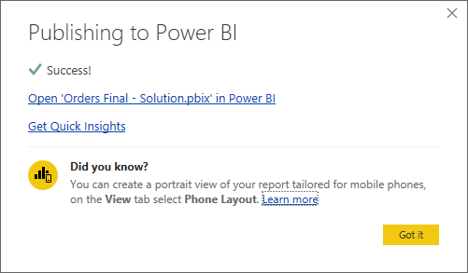
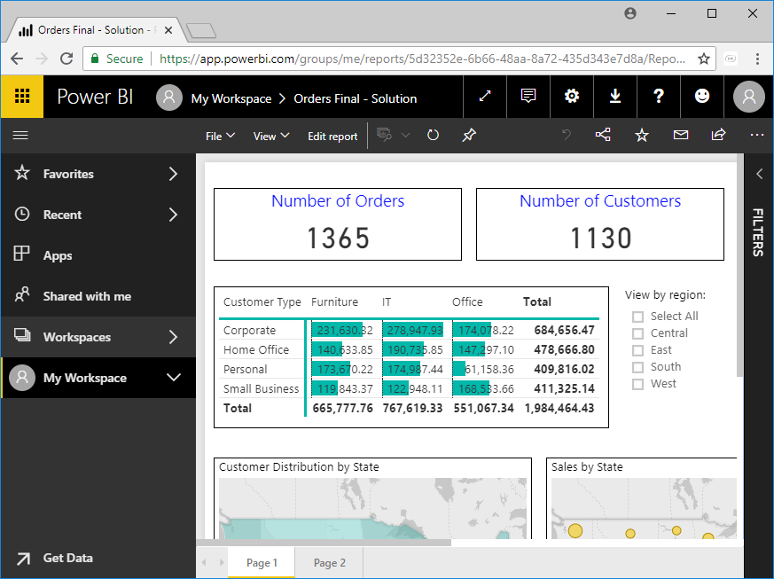
13 – Publishing and Sharing
Task: Publish a report.
Example: Publish the Orders – Final Solution report from Power BI Desktop to Power BI service.
Result: The report is published and opened in Power BI service.
Publishing Completed
Report in the Power BI service
Notes:
Instructor notes:
Cover content in learning materials
References:
ICDL Data Analytics - Foundation 1.0 (13.2 Publishing and Sharing Reports)
Further Resources:

Slide 90
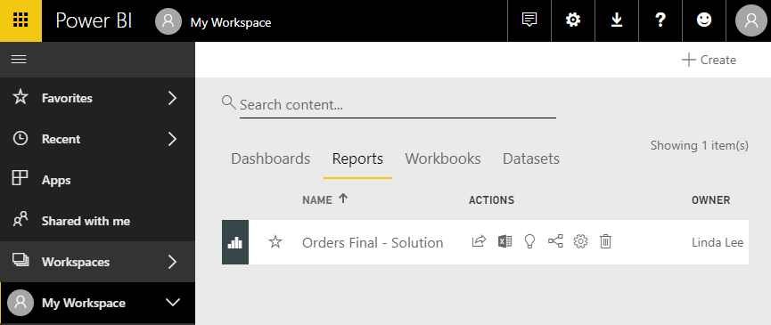
13 – Publishing and Sharing
Task: Publish a report.
Example: View the Orders Final - Solution report in the Power BI service.
Steps:
Sign into Power BI service at https://app.powerbi.com
Select My Workspace and click heading Reports.
Click on the report name Orders Final - Solution to view it.
Published Report List
Notes:
Instructor notes:
Cover content in learning materials
References:
ICDL Data Analytics - Foundation 1.0 (13.2 Publishing and Sharing Reports)
Further Resources:

Slide 91
13 – Publishing and Sharing
Task: Publish a report.
Example: View the Orders Final - Solution report in the Power BI service.
Result: The Orders Final - Solution report is opened in Power BI service.
Report in Power BI Service
Notes:
Instructor notes:
Cover content in learning materials
References:
ICDL Data Analytics - Foundation 1.0 (13.2 Publishing and Sharing Reports)
Further Resources:

Slide 92
13 – Publishing and Sharing
Task: Share a report using a link
Example: Share the Orders Final - Solution report from Power BI service using a link in email.
Steps:
If already in the open report click the Share icon. Alternatively, if not in Power BI service, sign in at https://app.powerbi.com select My Workspace, click Reports and click the Share icon.
Enter the email addresses in the Share report window and click Share.
Power BI service
Notes:
Instructor notes:
Cover content in learning materials
References:
ICDL Data Analytics - Foundation 1.0 (13.2 Publishing and Sharing Reports)
Further Resources:

Slide 93
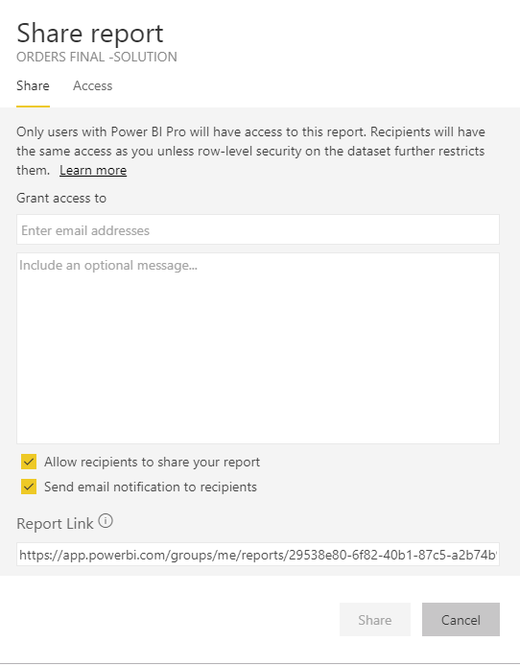
13 – Publishing and Sharing
Task: Share a report using a link
Example: Share the Orders Final - Solution report from Power BI service using a link in email.
Result: Recipients entered in the Share report pane receive the link to the report.
Email address field
Notes:
Instructor notes:
Cover content in learning materials
References:
ICDL Data Analytics - Foundation 1.0 (13.2 Publishing and Sharing Reports)
Further Resources:

Slide 94
13 – Publishing and Sharing
Task: Share a report to the Web
Example: Share the Orders Final - Solution report from Power BI service by publishing to the web.
Steps:
If not already in Power BI service, sign in at https://app.powerbi.com.
In the My Workspace section, click on the heading Reports.
Select the Orders Final - Solution report to open it.
Select File menu and choose Publish to web.
In the Embed in a public website window, click Create embed code.
Confirm the data is okay to embed in a public website and click Publish.
A window appears that provides a link or HTML that can be pasted directly.
Click Close.
Power BI service
Notes:
Instructor notes:
Cover content in learning materials
References:
ICDL Data Analytics - Foundation 1.0 (13.2 Publishing and Sharing Reports)
Further Resources:

Slide 95
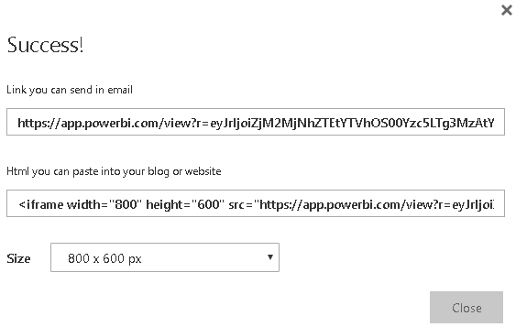
13 – Publishing and Sharing
Task: Share a report to the Web
Example: Share the Orders Final - Solution report from Power BI service by publishing to the web.
Result: You receive a link that can be sent in email and HTML that you can past directly into your web page or blog.
Link and HTML
Notes:
Instructor notes:
Cover content in learning materials
References:
ICDL Data Analytics - Foundation 1.0 (13.2 Publishing and Sharing Reports)
Further Resources:

Slide 96
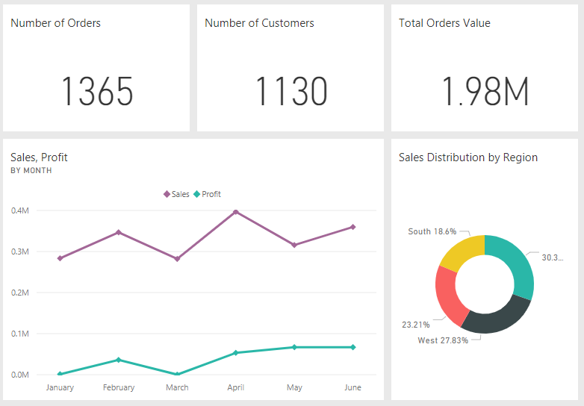

13 – Publishing and Sharing
Concepts: Creating Dashboards.
A Dashboard
can only be created in Power BI service.
A Dashboard is
Made up of tiles
Interactive
Customisable
Visual display of key information on a single screen
A Tile
A visualization
Pinned from a report
Updates as the underlying data updates
Notes:
Instructor notes:
Cover content in learning materials
References:
ICDL Data Analytics - Foundation 1.0 (13.3 Creating Dashboards)
Further Resources:

Slide 97
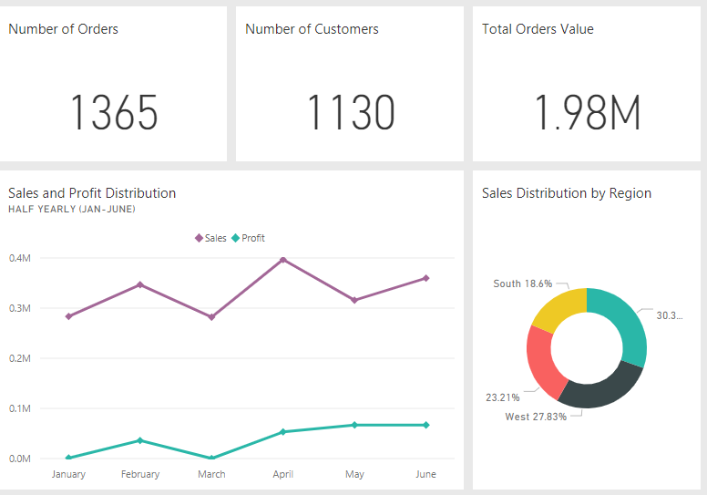
13 – Publishing and Sharing
Task: Creating Dashboards
Example: Create a dashboard called Orders Dashboard using visualizations from the Orders – Final Solution report.
Steps:
In Power BI Service select My Workspace and select Orders Final - Solution.
On Page 1, hover over Number of Orders and click the pushpin icon.
Select New dashboard and type Orders Dashboard.
Click Pin.
From page 1 pin Number of Customers card & Total Orders Value card to Orders Dashboard.
From page 2 pin Sales and Profit by Month line chart & Sales Distribution by Region donut chart to Orders Dashboard.
Hover over the tiles, click the resize handle and resize tiles as required.
Hover over the line chart and click on More options icon (...).
Select Edit details.
Enter Title: Sales and Profit Distribution and Subtitle: Half Yearly (Jan to Jun) and click Apply.
Power BI service
Notes:
Instructor notes:
Cover content in learning materials
References:
ICDL Data Analytics - Foundation 1.0 (13.3 Creating Dashboards)
Further Resources:

Slide 98
13 – Publishing and Sharing
Task: Creating Dashboards
Example: Create a dashboard called Orders Dashboard using visualizations from the Orders – Final Solution report.
Result: The Orders Dashboard is created.
To permanently remove a tile, select Delete tile from the ellipsis dropdown menu.
Dashboard Created
Notes:
Instructor notes:
Cover content in learning materials
References:
ICDL Data Analytics - Foundation 1.0 (13.3 Creating Dashboards)
Further Resources:

Slide 99

13 – Publishing and Sharing
Task: Share a dashboard using a link.
Example: Share the Orders Dashboard from Power BI service using a link in an email.
Steps:
In Power BI service, select My Workspace and select Orders Dashboard.
Click the Share icon under the Actions column.
In the Share Dashboard window, type the full email addresses of the recipients, separating each with a space.
Remember, the Sender and Recipient need Power BI Pro license
Check the options at the bottom part of the window as required.
Click Share.
You can modify access rights for recipients of a dashboard or report by selecting Access in the Share window.
Power BI service
Notes:
Instructor notes:
Cover content in learning materials
References:
ICDL Data Analytics - Foundation 1.0 (13.4 Sharing Dashboards)
Further Resources:

Slide 100

13 – Publishing and Sharing
Task: Share a dashboard using a link.
Example: Share the Orders Dashboard from Power BI service using a link in an email.
Result: Recipients receive an email invitation with a link to the shared dashboard and you receive a message confirming that the dashboard has been shared.
Sharing Message
Notes:
Instructor notes:
Cover content in learning materials
References:
ICDL Data Analytics - Foundation 1.0 (13.4 Sharing Dashboards)
Further Resources:

Slide 101
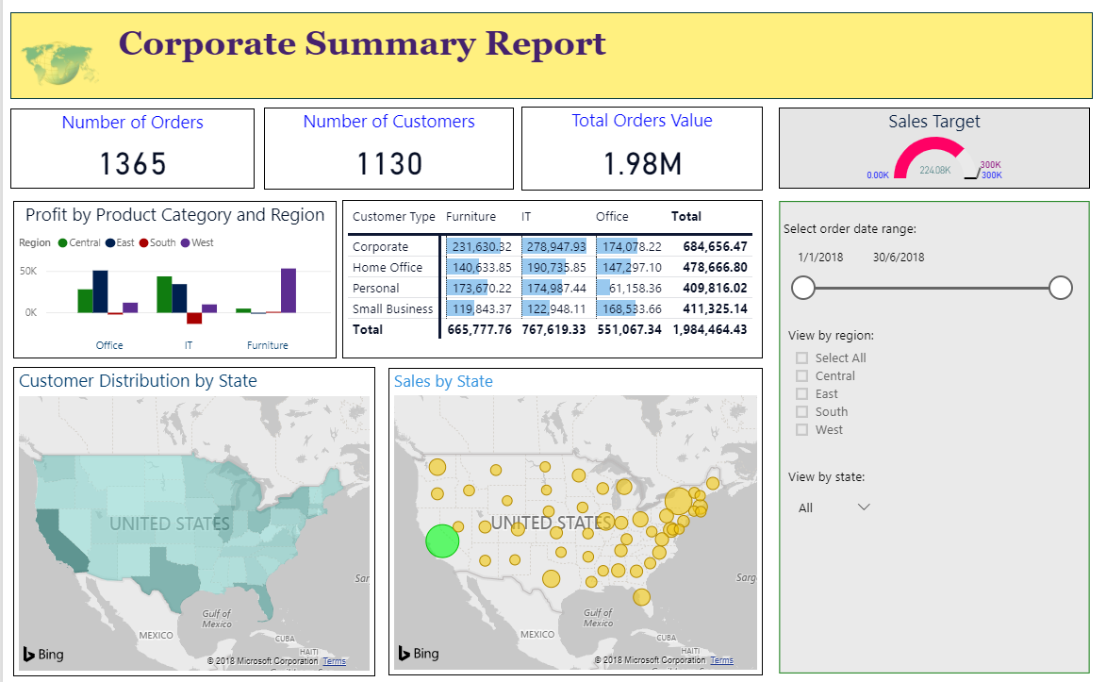
13 – Publishing and Sharing
Concepts: Understand good design practice in reports and dashboards.
Clean and Uncluttered Layout
Include only the most relevant data so the reader can easily see the key insights.
Notes:
Instructor notes:
Cover content in learning materials
References:
ICDL Data Analytics - Foundation 1.0 (13.5 Good Design Practice)
Further Resources:
Best design practices for reports and visuals (https://docs.microsoft.com/en-us/power-bi/visuals/power-bi-visualization-best-practices)

Slide 102
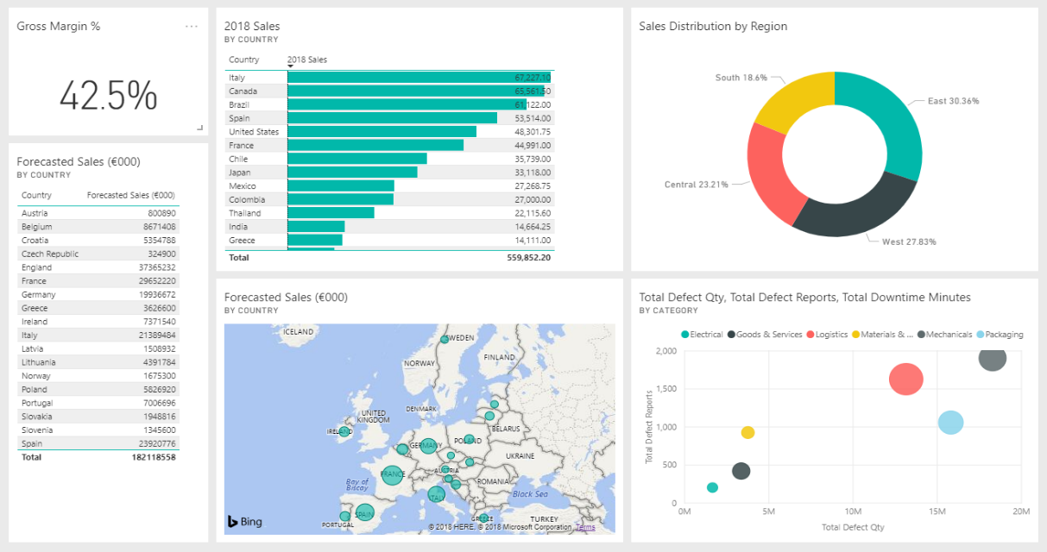
13 – Publishing and Sharing
Concepts: Understand good design practice in reports and dashboards.
Descriptive Titles
Use descriptive titles to help readers understand data visualizations.
Add labels in text boxes to describe the page, groups of visualizations, or individual visualizations.
Notes:
Instructor notes:
Cover content in learning materials
References:
ICDL Data Analytics - Foundation 1.0 (13.5 Good Design Practice)
Further Resources:
Best design practices for reports and visuals (https://docs.microsoft.com/en-us/power-bi/visuals/power-bi-visualization-best-practices)

Slide 103
13 – Publishing and Sharing
Concepts: Understand good design practice in reports and dashboards.
Consistent Fonts and Colour
Use one or two font types
Use up to three font sizes to create a visual hierarchy among the content, for example:
Titles
Labels
Data
Use colour to help the reader understand the report
Using too many different colours can be distracting
Notes:
Instructor notes:
Cover content in learning materials
References:
ICDL Data Analytics - Foundation 1.0 (13.5 Good Design Practice)
Further Resources:
Best design practices for reports and visuals (https://docs.microsoft.com/en-us/power-bi/visuals/power-bi-visualization-best-practices)

Slide 104
13 – Publishing and Sharing
Concepts: Understand good design practice in reports and dashboards.
Use of Colour for Emphasis and Understanding
Use mainly natural colours
Use bright or dark colours for highlighting outliers or critical data
Use colour shades or gradients to show the spread of values
Use colour to highlight variance around a central value
For example, green to show positive values and red to show negative values.
Notes:
Instructor notes:
Cover content in learning materials
References:
ICDL Data Analytics - Foundation 1.0 (13.5 Good Design Practice)
Further Resources:
Best design practices for reports and visuals (https://docs.microsoft.com/en-us/power-bi/visuals/power-bi-visualization-best-practices)

Slide 105
13 – Publishing and Sharing
Concepts: Evaluating Results.
1. Business understanding
2. Data understanding
3. Data preparation
4. Modelling
5. Evaluation
6. Deployment
Consider:
What insights have you gained?
Do the insights address the original problem/goals?
What practical solutions can you implement/deploy?
Is further analysis required?
What is the next phase?
Data Analysis Phases
Notes:
Instructor notes:
Cover content in learning materials
References:
ICDL Data Analytics - Foundation 1.0 (13.6 Evaluating Results)

Slide 106
13 – Publishing and Sharing
Learning Objectives Review
You should now be able to:
Publish a report from Power BI Desktop to the Power BI service
Share a report from the Power BI service using a link
Share a report from the Power BI service to the Web
Create a dashboard in the Power BI service
Share a dashboard in the Power BI service
Understand good design practice in reports and dashboards
Notes:
Instructor notes:
Review learning objectives

Slide 107
13 – Publishing and Sharing
Review Exercise
Notes:
Instructor notes:
Ask participants to complete the Review Exercise to review their knowledge and practice their skills and support them as required.
They will need access to Power BI Desktop and Service and an email address with which to share the Orders Metric file
Review answers with the group
Question answers
1 a)
2 Result: The Orders Metric file is shared
3 c)
4 a), b), c)
References:
ICDL Data Analytics - Foundation 1.0 (13.7 Review Exercise - page 216)
Relevant workfile in Student folder (Orders Metric)

Slide 108
Data Analytics – Foundation 1.0
Programme Learning Objectives Review
You should now be able to:
Understand the key concepts relating to the application of Data Analytics in business.
Understand and apply key statistical analysis concepts.
Import data into a spreadsheet and prepare it for analysis using data cleansing and filtering techniques.
Summarise data sets using pivot tables and pivot charts.
Understand and apply data visualization techniques and tools.
Create and share reports and dashboards in a data visualization tool.
Notes:
Instructor notes:
Review the overall course learning objectives

Slide 109

Questions
Notes:
Instructor notes:
Ask participants if they have any final questions

Slide 110

Course Evaluation
Notes:
Instructor notes:
Ask participants for their feedback on the course

Slide 111

Congratulations!
You have completed the programme.
You should now be ready to take ICDL certification testing.
Notes:
Instructor notes:
As applicable, explain that participants should now be ready to take the ICDL Data Analytics - Foundation Certification

Slide 112

Contacts
For further information,
contact:
<insert name of contact and contact details>
Notes:
Instructor notes:
Provide contact details

